Slide 1
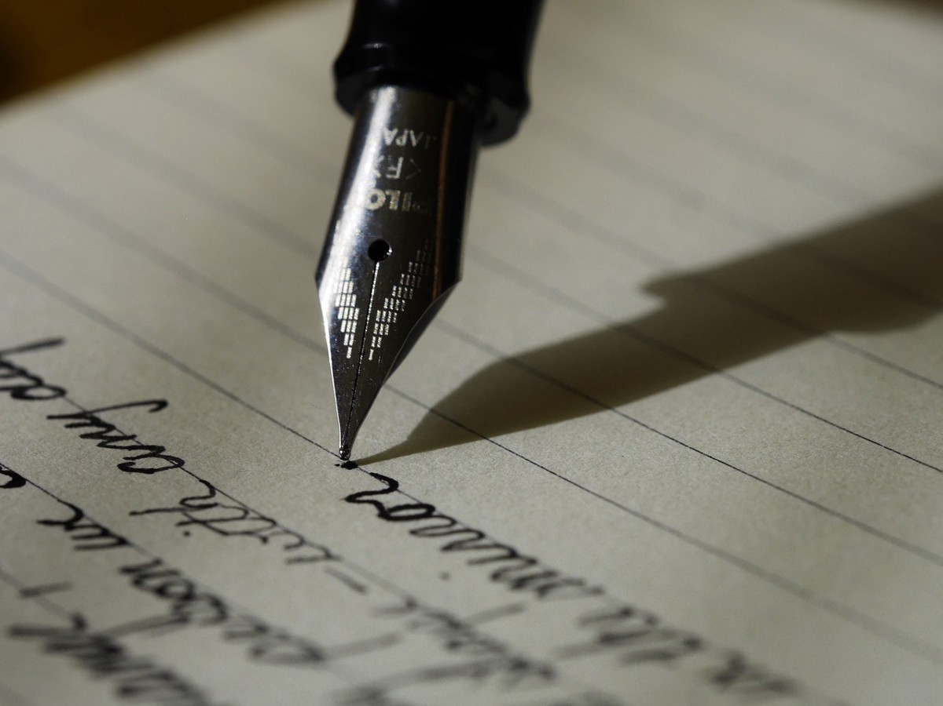
Application of Neural Networks in Smoothing Handwriting
By Muchigi Kimari, Edward Fry, Ikenna Nwaogu and YuMei Bennett
Advisor: John santerre

Slide 2

Agenda
Problem Statement
Background
Data
Methods
Results
Ethical Discussion
Conclusions
Questions
Citations

Slide 3

Problem Statement

Slide 4

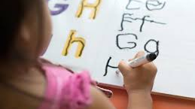
Problem Statement
Dysgraphia is Motor disorder
Difficult expressing ideas on paper

Slide 5

Background

Slide 6

Symptoms of Dysgraphia at home
Illegible handwriting
Difficulty drawing
Spelling errors
Tight hold on pen
Omitting letters and words from sentences
Trouble filling
Mixing of lowercase and uppercase letters
Often leaves out individual letters
Able to explain self clearly when speaking but not when writing

Slide 7
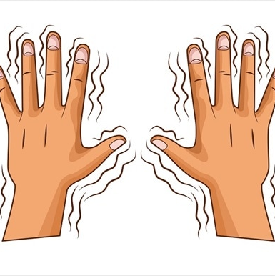
What causes dysgraphia?
Orthographic coding
When is handwriting needed?

Slide 8
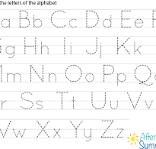
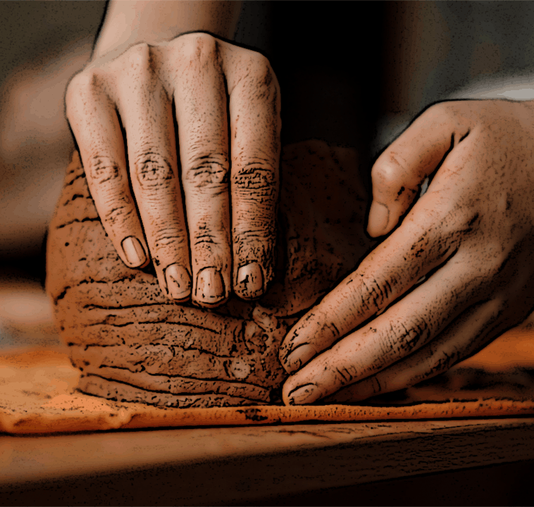
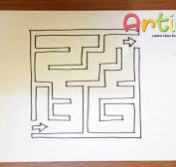
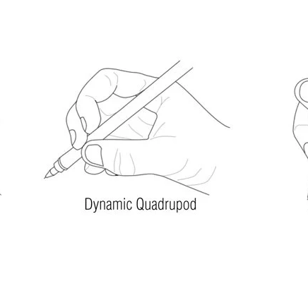
Dysgraphia has no cure!!
Therapeutic activities may include:

Slide 9
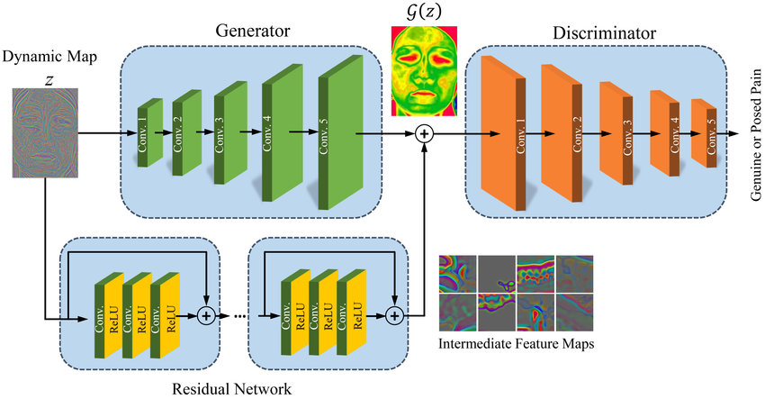
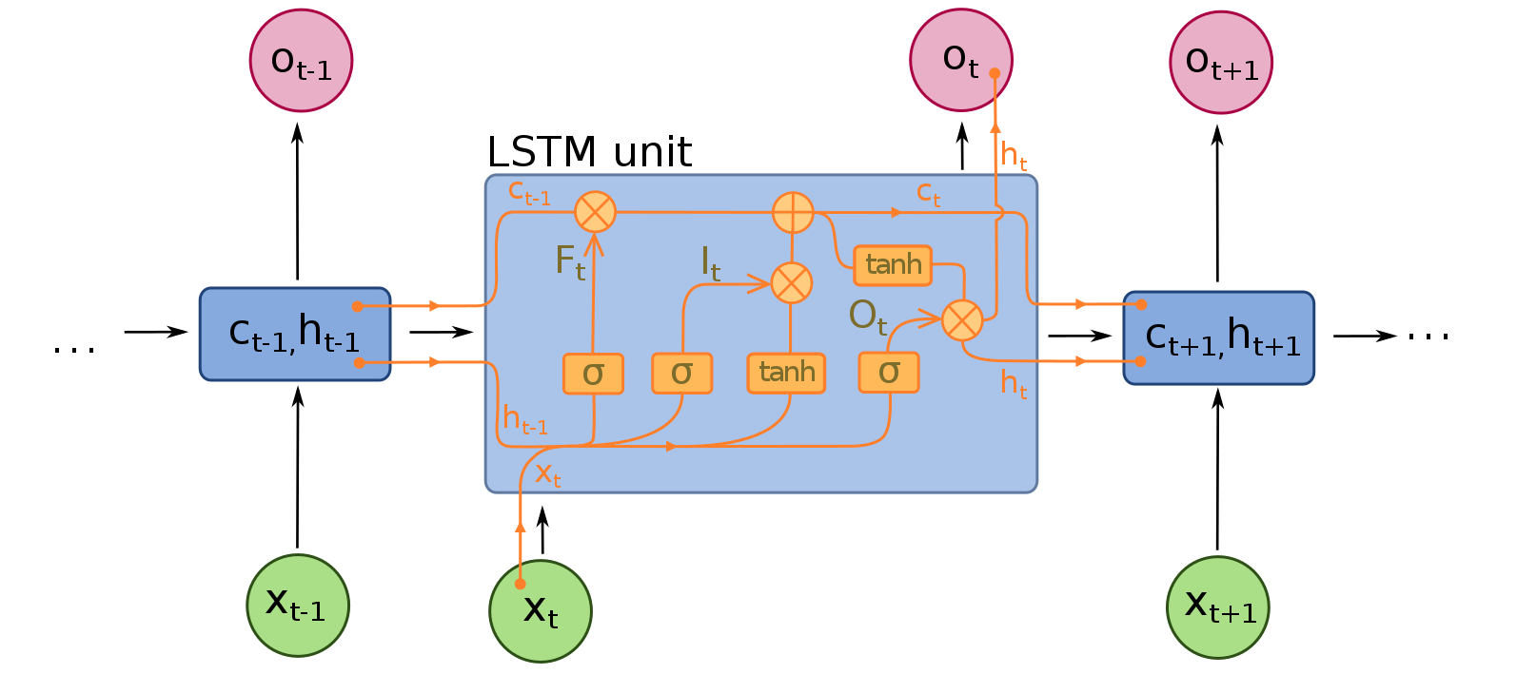
Solution
Generative Adversarial Network
LSTM

Slide 10
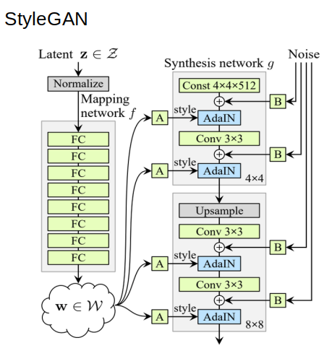
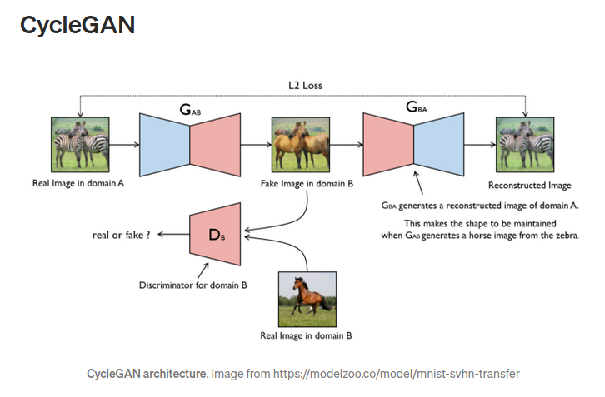
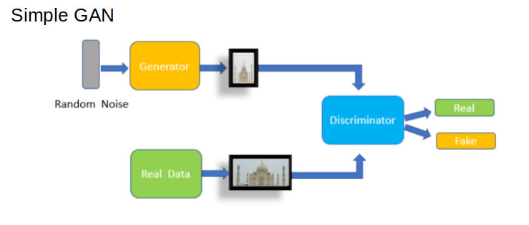
Generative Adversarial Networks
GAN OVERVIEW

Slide 11
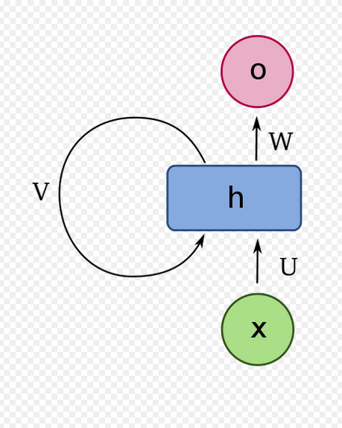
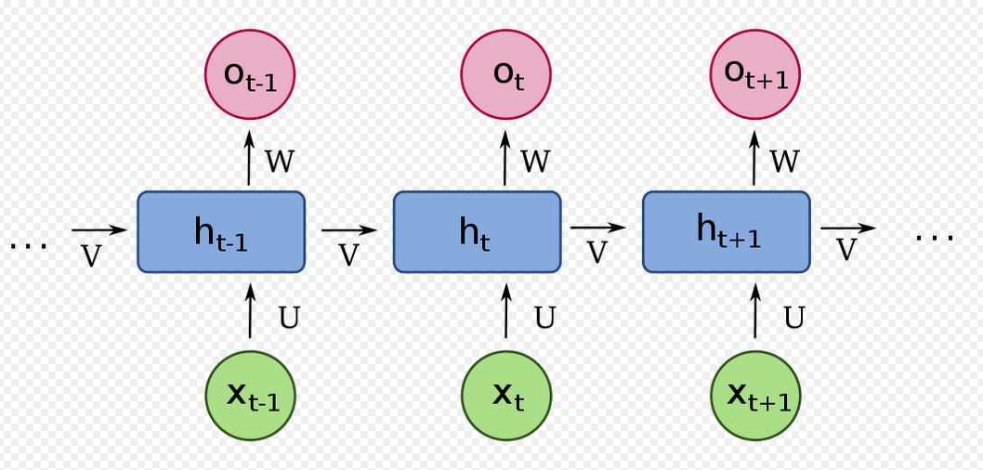
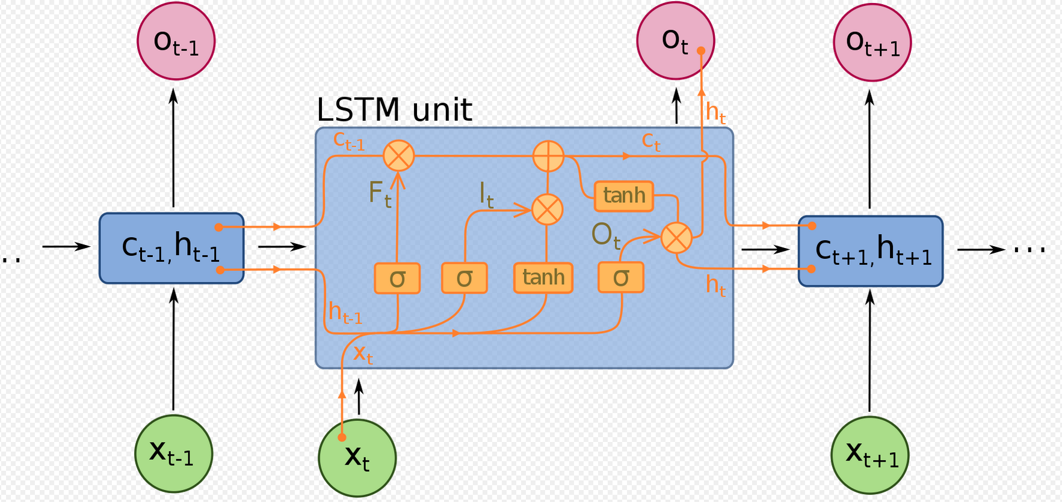
Long Short-Term Memory

Slide 12
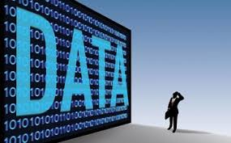
The following data sources were considered.
EMNIST Dataset
IAM Handwriting Top50
Yu Qiao
A-Z Handwritten Alphabets

Slide 13
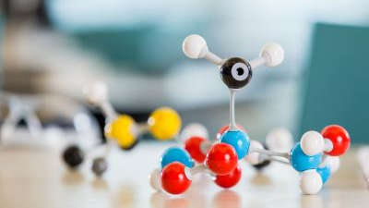
Methods

Slide 14



Tools and Utilities

Slide 15

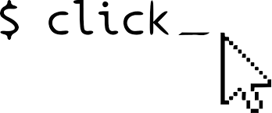

Tools and Utilities

Slide 16
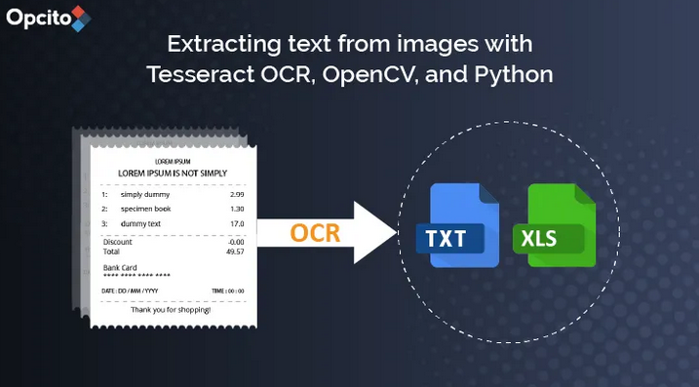
Generative Adversarial Network
Step 1 – Load data
Step 2 – Build GAN Model
Step 3 – Train
Step 4 – Prediction

Slide 17
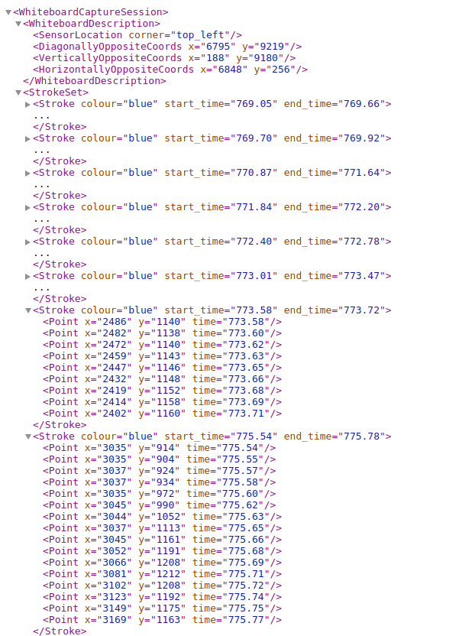
Data Structure
Stroke Dataset
Stroke Set
Stroke
Point

Slide 18

LSTM Training
Step 1 – Load data
LSTMDataInterface is a function
Step 2 – Build LSTM
Our LSTM model comprises of:
A GRU function from pytorch
A linear layer for classification
A SoftMax and entropy loss
Step 3 – Train
Step 4 – Prediction

Slide 19

Results

Slide 20
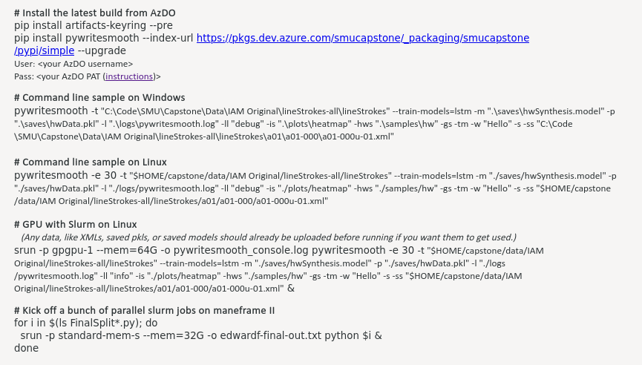
RESULTS

Slide 21
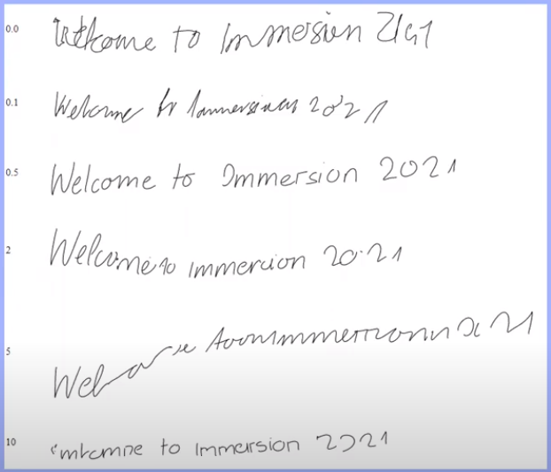
Final Product

Slide 22
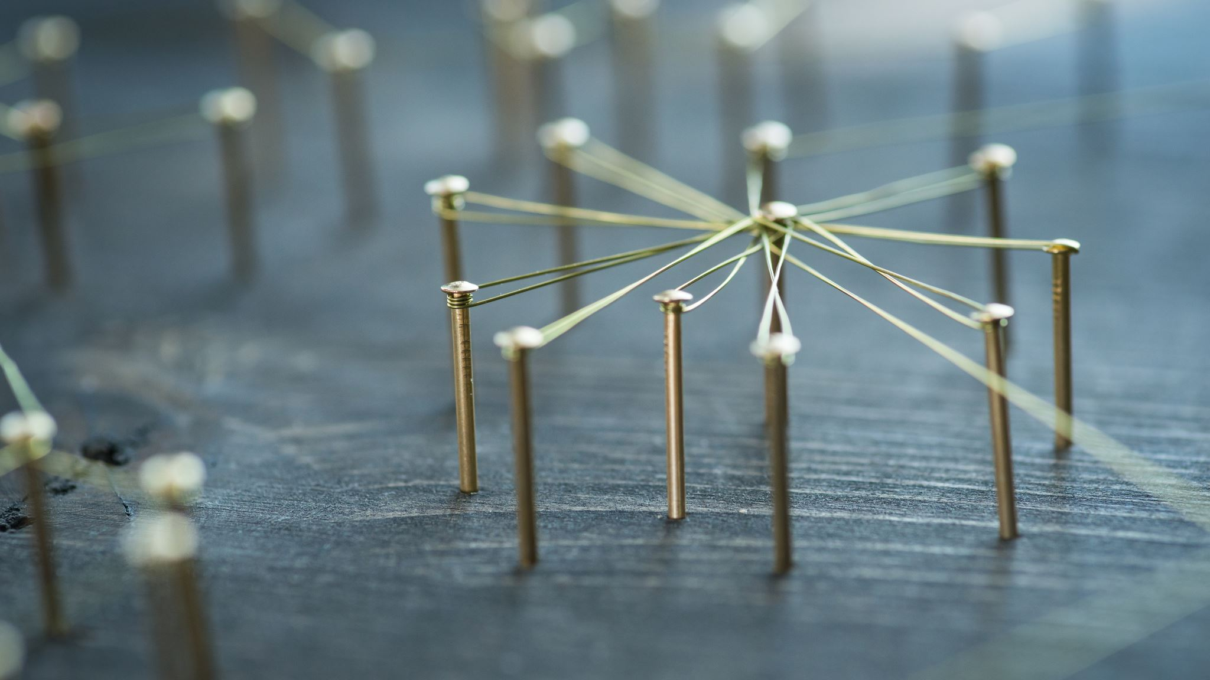
Discussion

Slide 23

Discussion/Ethical

Slide 24
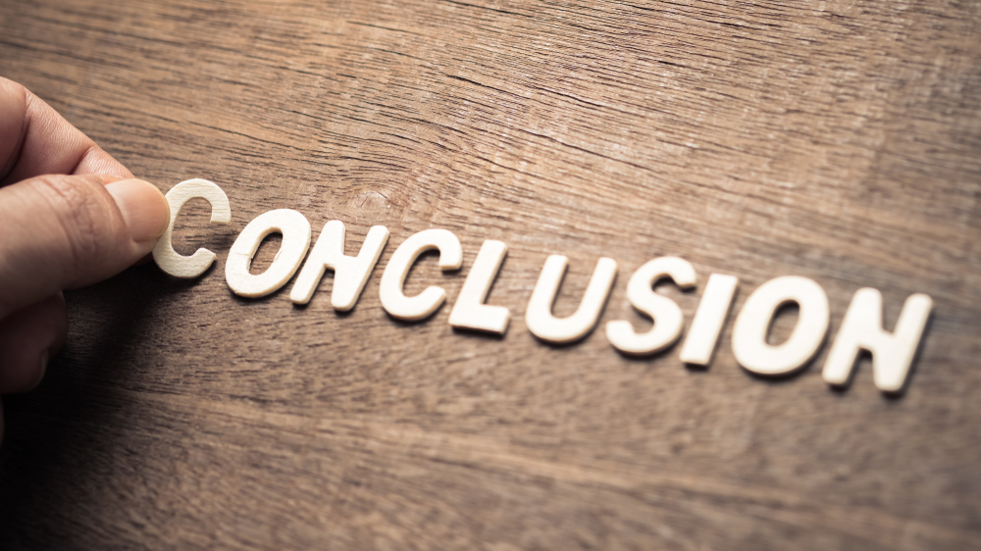

Slide 25
Conclusion
The aim for this application is to help people impacted by Dysgraphia to communicate better
We hope that this application will promote additional research

Slide 26

THANKS!
Any questions?

